Slide 1

Project Status Report 1
Team Ehrgo Health
03/13/16
Notes:
This template can be used as a starter file to give updates for project milestones.
Sections
Right-click on a slide to add sections. Sections can help to organize your slides or facilitate collaboration between multiple authors.
Notes
Use the Notes section for delivery notes or to provide additional details for the audience. View these notes in Presentation View during your presentation.
Keep in mind the font size (important for accessibility, visibility, videotaping, and online production)
Coordinated colors
Pay particular attention to the graphs, charts, and text boxes.
Consider that attendees will print in black and white or grayscale. Run a test print to make sure your colors work when printed in pure black and white and grayscale.
Graphics, tables, and graphs
Keep it simple: If possible, use consistent, non-distracting styles and colors.
Label all graphs and tables.

Slide 2
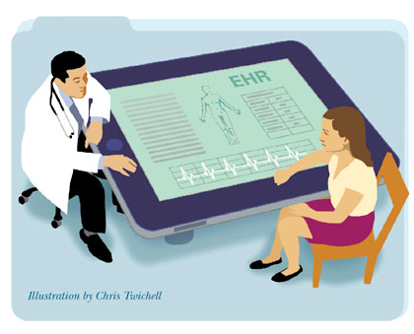
Project Overview
Plugin architecture to capture treatment analysis from EHR
Patient Portal: allowing patient to enter personal information and leverage commonly-used technology APIs such as the Fitbit API
Provider EHR plugin: show warnings between allergies/medication and optimize treatment strategies
Notes:
What is the project about?
Define the goal of this project
Is it similar to projects in the past or is it a new effort?
Define the scope of this project
Is it an independent project or is it related to other projects?
* Note that this slide is not necessary for weekly status meetings

Slide 3
Architecture
Complete
In Work
Not Started
EHR Framework
Patient Data Get/Set View
Calculate Optimal Treatment View
Alert Service
Data Entry
Plan
Treatment Plan Service
EHR Provider Plugin
Decider Process
Patient App
Public Interface
Patient Data Interface
FHIR DB
EHR Repositories
EHR Repositories
EHR Repository
EHR Repository
Fitbit Data Repository
Patient Data Repository
Notes:
Here we see the architecture. Starting with the patient app, we see that it interacts with two sources of information. The patient data repository contains the patient's authentication information, and the fitbit repository contains the patient's dietary information. The patient app (as well could other EHR repositories) pass this information to the decider process, which dispatches the EHR Provider plugin to fetch the patient's data and allergy information from the FHIR database. The decider process uses the fetched data to make a decision regarding the current treatment plan for a patient and reports its findings back to the EHR that requested the information.

Slide 4
Database Overview
FHIR DB
Retrieves allergy of a specific patient and allergy intolerance resource
EHR Repositories
Patient’s data from other EHR’s databases
Fitbit Data
Dietary Data
Patient Data Repository
Stores login data for patients and administrators
Patient Data Repository
FirstName | LastName | Email | PassHash | UniqueID
Notes:
Database Overview. So we have the FHIR database which contains the allergy of a specific patient.
We have EHR Repositories, which contain patient data from respective databases of other EHR's.
We also Fitbit Data which contains the patient's dietary data
And finally, we have the Patient Data Repository from our Patient app, which contains the login data for patients and administrators

Slide 5
Functional Requirements
Staff portal
page to add basic data about a patient (weight, height, etc)
page to port data for a patient from an EHR
page to assign treatments/medications to a user
User Portal
page to port dietary data from fitbit
page to port existing EHR data from other sources
page to view treatments/medications, and any warnings associated with them
Treatment Service
Service should take in patient data (no saving), allergy info, history, and treatment regime and return warnings if treatments will cause issues. This includes IV medication timings, and prescription interactions.
Service should also return any data regarding time components of treatment regimes
Notes:
There are three main components for Functional Requirements. The staff portal is means for trained medical staff to enter information about a patient. The user portal which is a means for the patient to upload information about themselves from a device, and a treatment service which decides the safety level of the patient's current treatment plan.

Slide 6
Technology Requirements
ASP .NET
Version 4.6.1
MVC 5
Web API 2.1
ASP.NET Identity 2
Entity Framework
Fhir.Net
Bootstrap
jQuery
Knockout

Slide 7
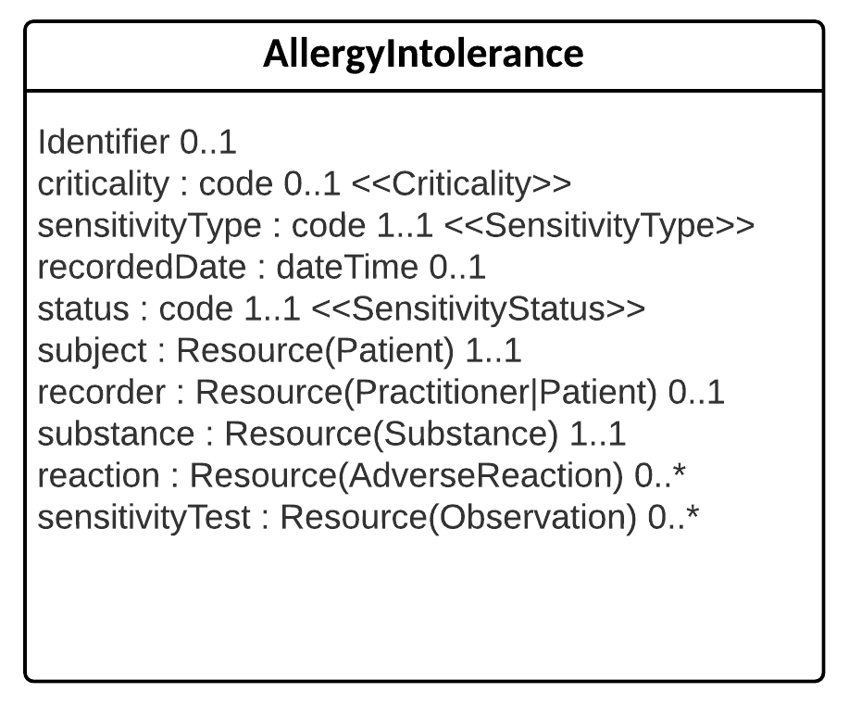
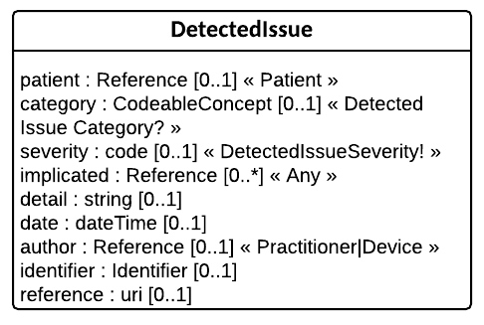
EHR Plugin Data Analysis
Through observation and patient history a provider can analyze if there is a relationship between a substance and subsequent reaction that would lead to a diagnosis of an allergy.
Using available FHIR resources this information can be pulled into the EHR.
The plugin architecture would provide alerts to the provider regarding potential issues and dangers regarding current course of treatment.
A treatment plan can be created to avoid potentially life-threatening conflicts.

Slide 8
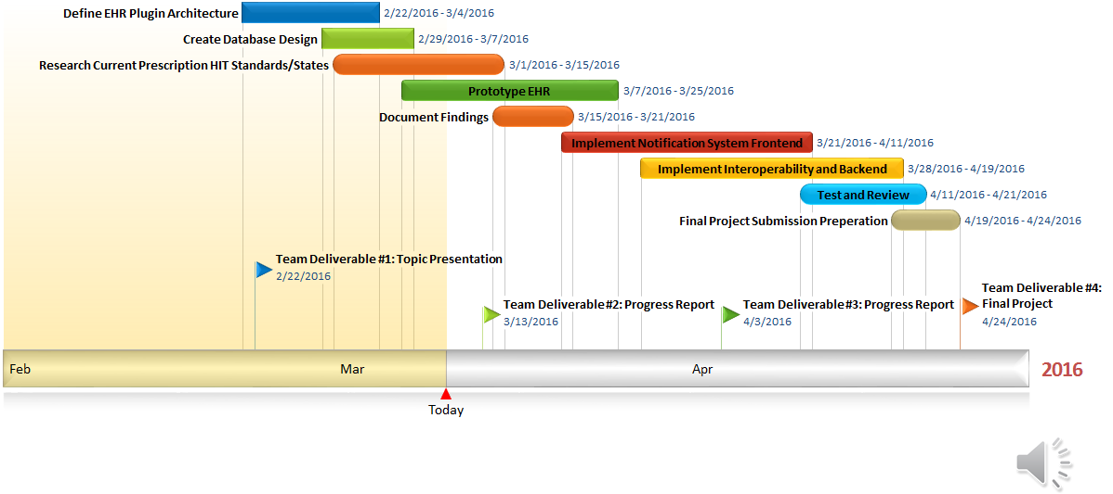
Progress Chart

Slide 9
Current Status
What progress has been made since the previous milestone?
EHR Plugin Architecture Defined
Database Design Detailed
Research into Target Platforms and Data Sources (FHIR requests, etc.) – at approximately 55% complete
Prototype EHR ~ 40% complete
Is the project currently ahead of schedule, on track, or delayed?
ON TRACK
Notes:
* If any of these issues caused a schedule delay or need to be discussed further, include details in next slide.

Slide 10
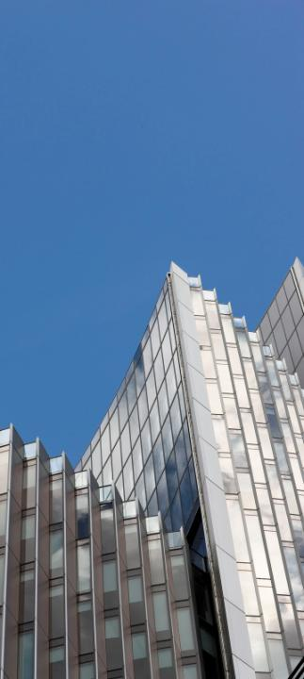
Looking Ahead
Next Milestone: April 3rd
Expected deliverables:
Completed EHR Prototype
Defined set of Project Risks
Target Platforms and Data Interop
Initial App Full Stack Development
Problem Item(s) List

Slide 11
Ehrgo Health Team Members
Eric Greene: Project Manager/Developer Narrator 2
Huarui Zheng: Developer/Tester
Donna Carey: Documentation Lead/Developer
Tommy Parnell: Development Lead/Documentation
James Ruiz: Developer/Tester Narrator 1
Notes:
Prepare slides for the appendix in the event that more details or supplemental slides are needed. The appendix is also useful if the presentation is distributed later.

